Slide 1
Water Tool Filters The Modular Sand Media Filter
Sand media filtration is one of the oldest filter processes in the world. Water Tool Modular Filters have made extensive improvements to what is presently available.

Slide 2
The Back Flush under drain is exclusively designed for the most efficient Back Flush.
Under drain covers the bottom area of the filter
Only vertical Back Flush flow, no wasted horizontal or downward flow
Reduces Back Flush time, thus saving water.
Reduces the depth of the media bed, saving initial media cost and manufacturing cost.
Gives as close to a 100 percent media efficiency cleaning as possible.

Slide 3
3. Constructed of non rust materials
A. Glass filled nylon tank, proven long lasting.
B. UVR PVC manifold system (Ultra-Violet Resistant)
This material has been used since its, development
in the late 1970s.

Slide 4
Easy installation
A. Light weight construction, saves on freight cost, installation equipment needed (no forklift required) and manpower needed.
B. Minimum tools needed, most connections are union type fittings requiring only hand tightening.
C. One man can install the entire system, no matter how many tanks.

Slide 5
Modular design
A. Each Modular filter is capable of a flow of 17-25 GPM, depending on media used.
B. Low flow system can now use sand media filtration.
C. As many Modular filters necessary can be added to meet the flow requirement of the system.
D. Modular filters can be added to or subtracted from the system to meet future flow requirements.

Slide 6
Back Flushing
A. Large tanks require high flows to back flush the media bed.
B. Water Tool Modular filters requires only 27-34 GPM to Back Flush the media bed. On most systems this will be only a small percentage of the total flow, thus keeping Back Flush pressure sufficient to provide a quick and thorough cleaning of the media bed, thus saving valuable water and eliminating expensive downstream pressure sustaining valves.

Slide 7
Automatic controls
A. The Back Flush controller can handle from 1 to 96 tanks. (The largest station controller available).
B. Only two control wires go from the controller to the Modular tank system, utilizing two wire/decoder technologies. Eliminating installation labor and problematic wire runs to each and every tank.
C. The Pressure Differential switch will operate if the controller is in the “Off” position, saving potential dangerous high differential problems.
D. The controller keeps track of the number of flush cycles in a resettable timing function that can be viewed at the controller.
E. The controller is equipped with a “switching” power supply, not a transformer, but a power regulator that can take input power from 90 to 250 volts, 50 or 60 Hz power and convert it to 12vdc for Back Flush solenoid operation. For remote installations, the Controller can be Solar powered with no additional controls needed, except the solar panel and battery.

Slide 8
Maintenance
A. The Back Flush valves can be removed from the system in less than one minute and reassembled in the same time.
B. The disassembly and reassembly of the Back Flush valve can be accomplished in less than 5 minutes if necessary.

Slide 9
Costs are comparable to existing markets
A. Considerable initial freight cost savings.
B. Major installation cost savings.
C. Low maintenance costs.

Slide 10
Overall the most efficient media filter available in today’s demanding market of water efficiency. All components necessary to install and operate this filter system are included in the package, pressure gauges, air release, adjustable pressure differential switch for initiating Back Flush cycle, automatic controller for Back Flush 1-96 tanks, valves, control valve filter, fittings….all included for easy and fast installation and operation.
Telephone: 1-800-468-0071
WWW.RAINPROCO.COM/WT

Slide 11
Three Tank System

Slide 12
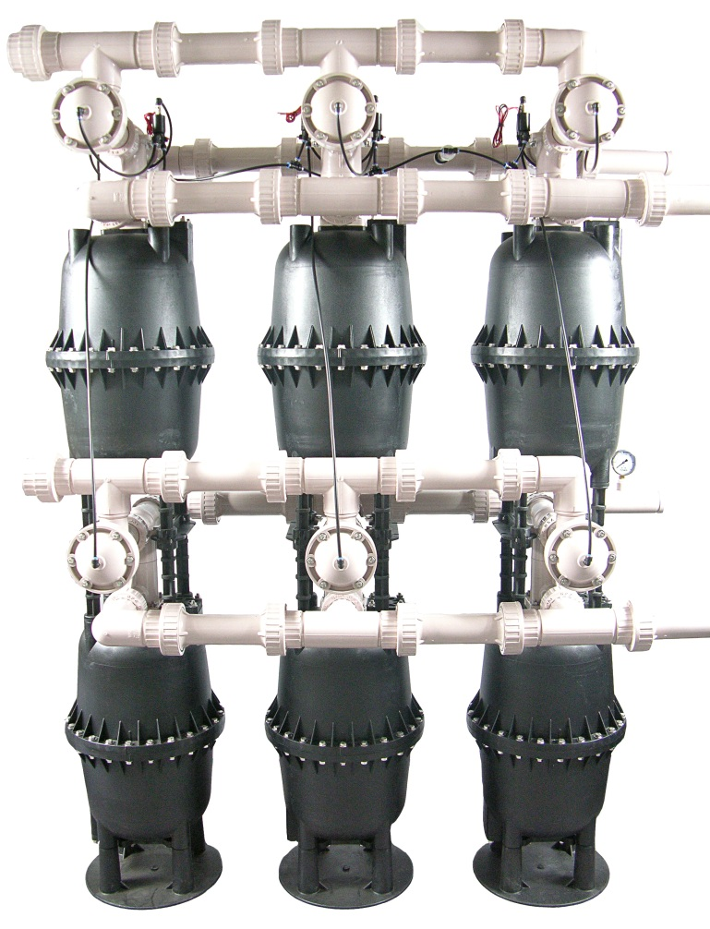
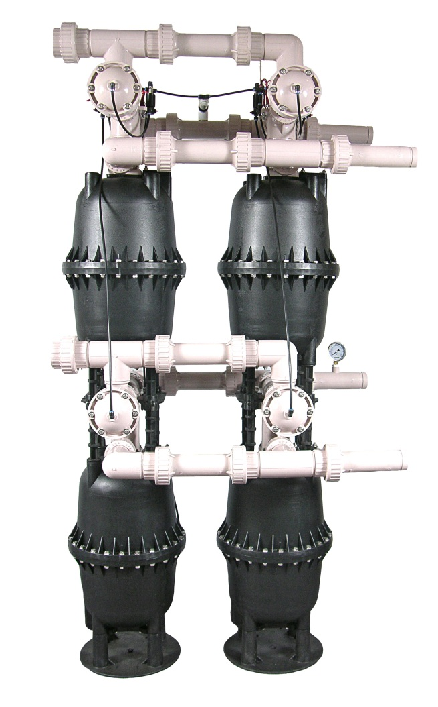
Six Tank System and 4 Tank System

