Slide 1

WATERMAN INDUSTRIES
  GREVSON INTERNATIONAL WATER
Notes:
SINCE 1912 WATERMAN HAS BEEN THE LEADING MANUFACTURE OF IRRIGATION AND WATER CONTROL PRODUCTS TO THE SURFACE, FLOOD AND WATER/WASTEWATER INDUSTRIES.

Slide 2
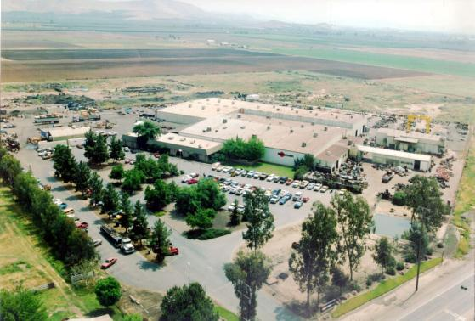
Waterman Industries
Exeter, California

Slide 3
BRIEF HISTORY
1912 – William Waterman founds the WA Waterman Company
1953 – Waterman designs and builds its first sluice and slide gates
1969 – The company moves into present location - [116,000 sq ft facility in Exeter, CA]
1970 - Don Appling, grandson of the founder, is promoted to CEO and sets an aggressive agenda to grow the company’s product line
1974 – Waterman introduces a new line of stainless steel and aluminum fabricated gates
2001 – Don Appling retires and sells Waterman to the 4th generation
2004 – Waterman is driven into bankruptcy after a series of poor management decisions
2005 – Galena National Investments purchases Waterman’s assets
2006 – Waterman emerges from bankruptcy, recruits a new management team, and aggressively builds market share
2007 – Wells Fargo signs a financing agreement with Waterman signaling their confidence in Waterman’s full recovery from bankruptcy
2010 – Waterman reintroduces numerous intermediate and light duty product options
2012 – Waterman brand will celebrate 100 YEAR ANNIVERSARY

Slide 4
Engineered Products
Waterman Engineered Cast Iron and Fabricated Gates and Valves are designed to service the Water and Waste Water Industries and are recognized world wide.
Waterman offers products that meet all AWWA specifications including C560, C561, and the new C562 spec [Al] once it is released.
Notes:
READ SLIDE
IT IS NOT UNCOMMON TO SEE THE WATERMAN PRODUCT SPECIFIED BY NAME IN PROJECTS AROUND THE WORLD.

Slide 5
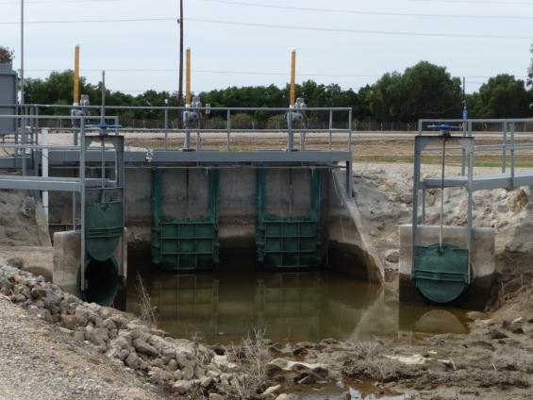
Cast Iron Sluice Gate Line

Slide 6
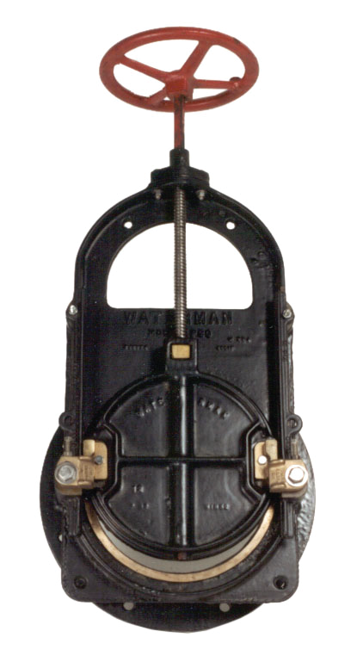
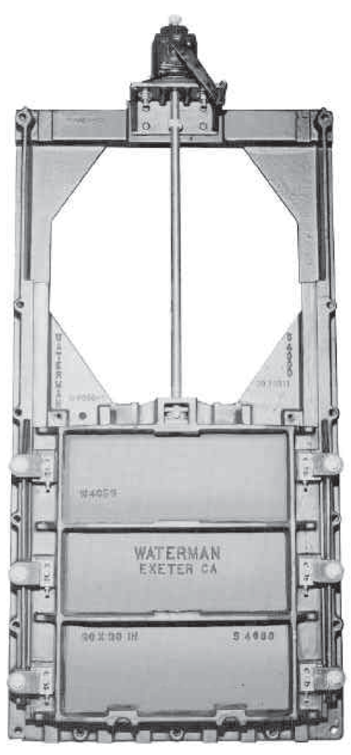
Models P-32 and 4000 Series

Slide 7
Models 5000 and 7000 Series
S-5000/QS-5900
QS-7000

Slide 8
Series 5000 and 7000 Sluice Gates
GENERAL DESCRIPTION
  Waterman Series 7000, 5000, 4000 and P-32 Heavy Duty Sluice Gates are designed and manufactured to meet or exceed AWWA Specifications C-560 (latest revision).

Slide 9
USES
  Waterman Heavy Duty Sluice Gates have been successfully used in a wide variety of applications, including municipal water works and treatment facilities, flood control projects, reservoirs and fish hatcheries.

Slide 10
FEATURES
  Gate shapes include square or rectangular with square, rectangular or circular opening, and can be furnished with standard flangeback or extended flangeback frames. All units feature adjustable corrosion-resistant side wedges and corrosion-resistant malleable seat facings locked in dovetail grooves. All mating or sliding surfaces are fully machined including close tolerance tongue and groove guides. All assembly hardware is of corrosion-resistant material.
OPTIONAL FEATURES
  Optional features available include Non-Rising Stem Adaptors, Flush Bottom Closures, Downward Opening Units, Top and Bottom Corrosion Resistant Adjustable Wedges, and fully Self-Contained Gates with extended guide rails, cast iron yoke, stem and lift.

Slide 11
Submittal Drawing
Notes:
11

Slide 12
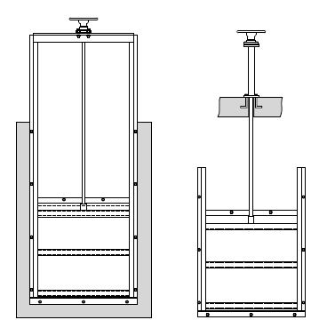
Self Contained Vs. Non-Self Contained
Self-Contained
Non-Self Contained

Slide 13
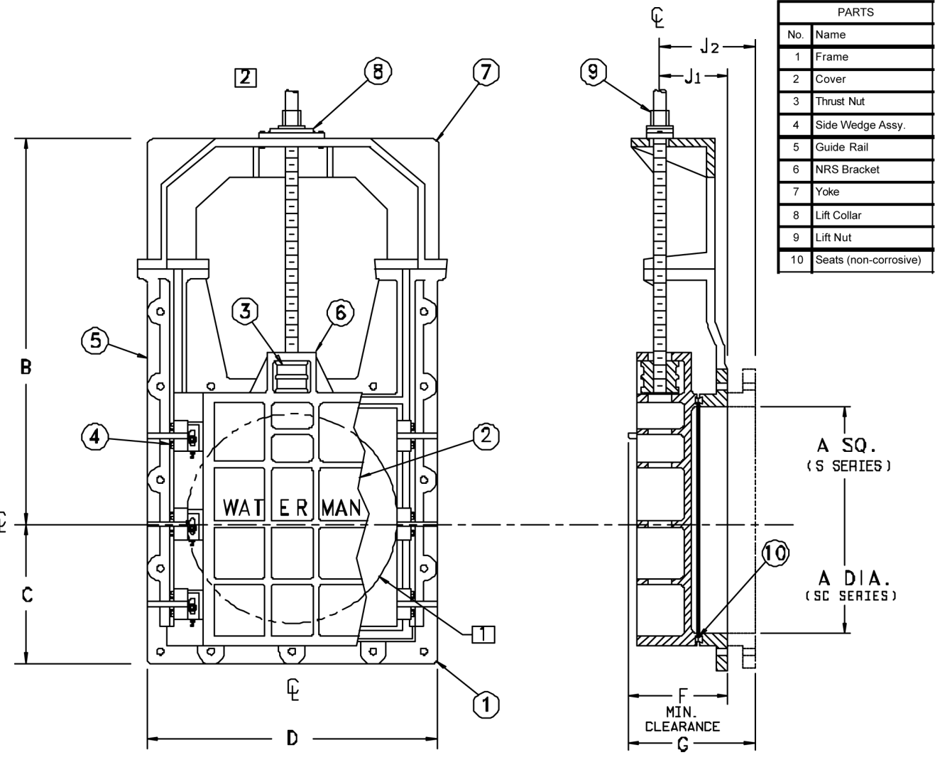
Non-Rising Stem

Slide 14
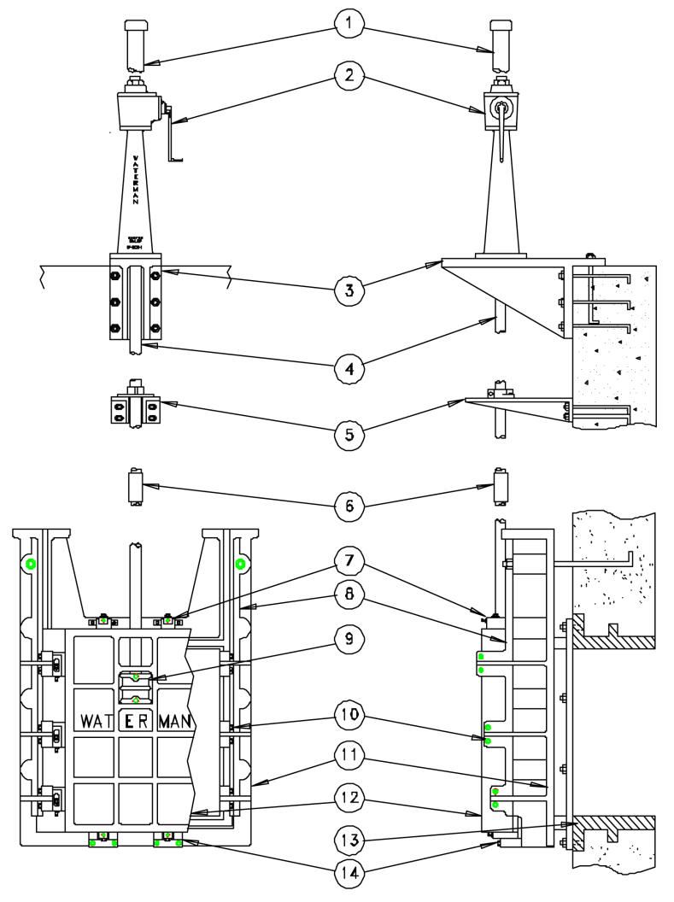
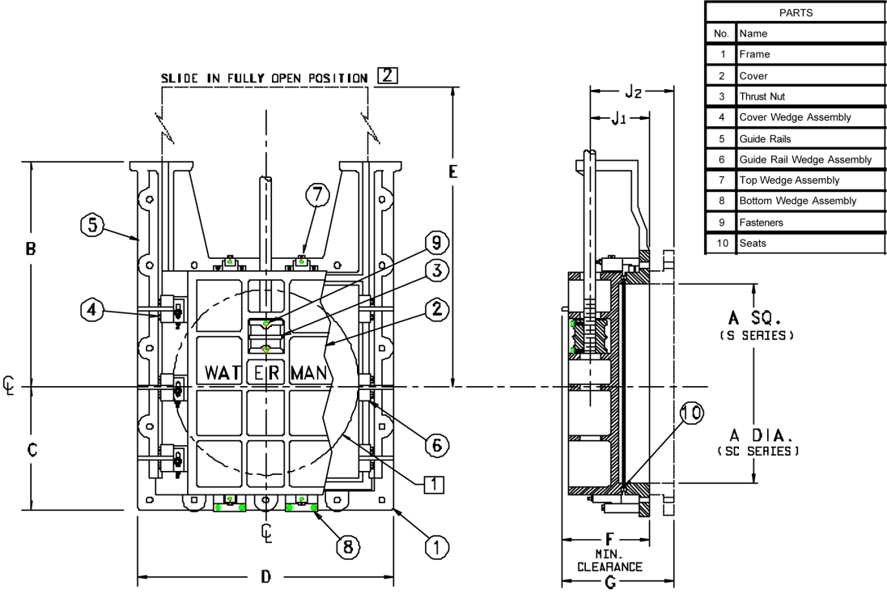
Rising Stem

Slide 15
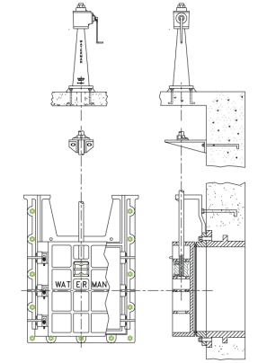
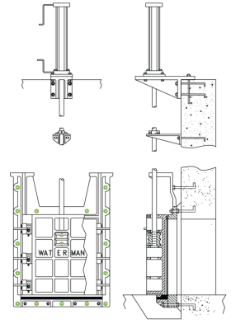
Standard Vs. QS Bottom Sealing
“Standard Sealing (4 sides)”
“QS Sealing - flushbottom ”

Slide 16
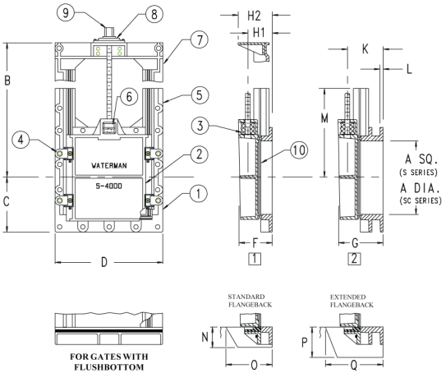
Standard Flangeback Vs. Extended Flangeback (“f”) vs. (“ff”)
“f”
“ff”

Slide 17
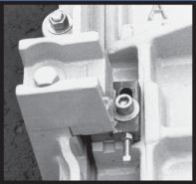
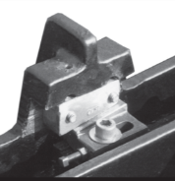
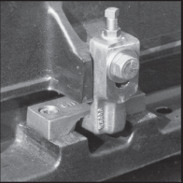
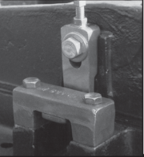
Wedge Systems
Type B
  Overhanging wedge block
  Adjustable portion on the slide
  Design allows for easy replacement in field
Type B-1
  designed for unit compatibility with all of Waterman's CNC sluice gate surfaces up to 48” in width
  Assures optimum mating of wedge and gate surfaces and a positive, leak-inhibiting closure
Top and Bottom Wedges
  Easily adjustable
  Locked into position with corrosion-resistant fasteners
  All sliding, mating, and wedging surfaces are fully machined
Waterman Standard
Type B-1 Wedge
Waterman Standard
Type “B” Wedge (overhang)
Top Wedge
Bottom Wedge

Slide 18
Cast Iron
Cast Iron (ASTM A-126, Cl B) – Sluice Gates; Is rugged & reliable, and has long track record in fresh water.
Cast Iron with 2% Nickel (ASTM A-126, Cl B)-Sluice Gates; Used to upgrade for minimal corrosion resistance.
Ductile Cast Iron (ASTM A-536) – Sluice Gates; Higher strength cast iron; rugged and reliable in fresh water.
Ni-Resist Cast Iron (ASTM A-436, Type 2 or 2B) – Sluice Gates; Very good in salt water or corrosive applications and environments.

Slide 19
Bronze
Silicon Bronze (ASTM B-584 , Alloy 873) – Sluice gate resilient WEDGE material; very tough and resilient
Magnesium Bronze (ASTM B-584, Alloy 865) – Sluice gate resilient WEDGE material; very tough and resilient
Naval Bronze (ASTM B-21, Alloy 482) – Sluice gate SEAT material and STEMS; high seat loading possible and high corrosion resistance; tough and resilient
Aluminum Bronze
Phosphor Bronze

Slide 20
Monel
Monel – (ASTM B-164, Alloy 400):
- 52-57% Nickel Bal % Copper. Slight
amounts of Aluminum, Carbon, Manganese,
Silicon, and Sulphur
- Sluice gate resilient WEDGE material
- Extremely tough and very high corrosion
resistant alloy (tough to machine!)

Slide 21
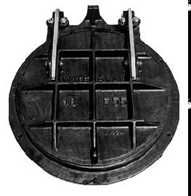
F-55 Flap Gate
Cast iron construction
Automatic operation
55 foot seating head maximum

Slide 22
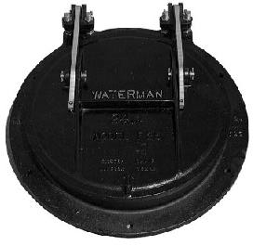
F-25 Flap Gate
Cast iron construction
Automatic operation
Fully adjustable hinge links
25 foot seating head maximum

Slide 23
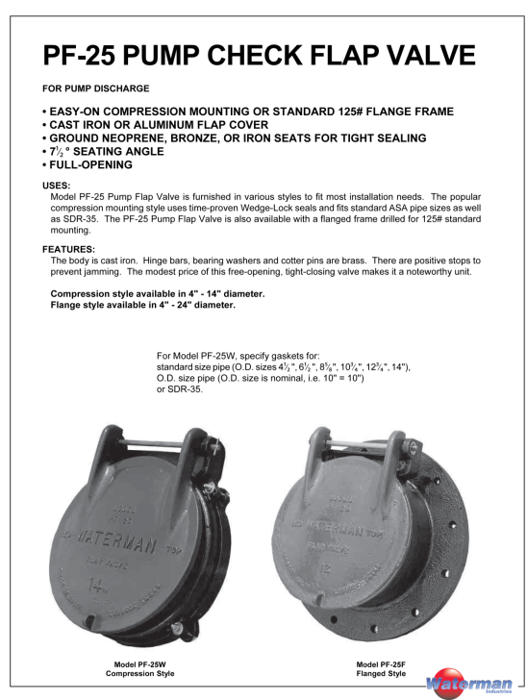

Slide 24
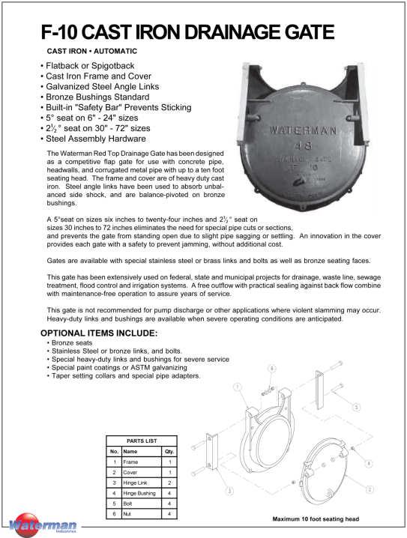

Slide 25
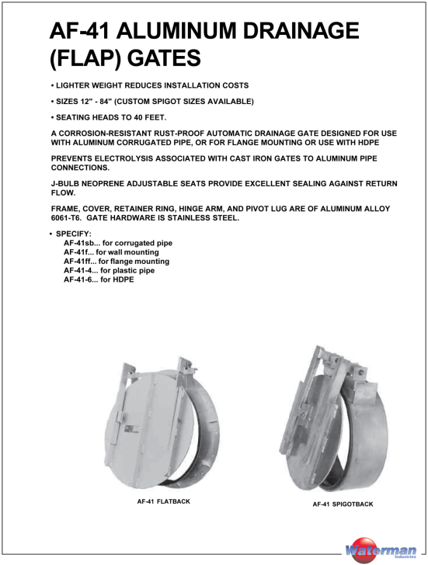

Slide 26
Fabricated Slide Gates
FABRICATED SLIDE GATES
  WATERMAN SLIDE GATES are used for open channel and wall-mounted applications in water, wastewater, sewage treatment facilities as well as fish hatcheries, industrial cooling systems, canal flow control, and many other uses.
  Generally slide gates depend upon water pressure to seat the slide. Watertightness improves as the head of water increases. Since there are no machined faces or wedging devices in most fabricated slide gates, there is generally no provision for unseating heads. Exceptions would be slide gates with optional resilient rubber seals. Resilient rubber seals provide the highest form of leakage resistance for fabricated slide gates.
  WATERMAN SLIDE GATES are designed and manufactured for specific applications, and can be specified for seating heads ranging from 5 feet to 25 feet. Materials include aluminum (mostly extruded), stainless steel and mild steel with appropriate coatings.
  WATERMAN can provide ultra high molecular weight polyethylene (UHMW) sliding and seating surfaces to reduce friction for ease of operation on most applications.

Slide 27
Stainless and Structural Steel
304 Stainless Steel – Fab Gates & Stems; Excellent in salt water, terrific corrosion resistance
316 Stainless Steel – Fab Gates & Stems; Same as 304 SS but even better corrosion resistance
2205 Duplex Stainless
A-36 Structural Steel – Fab Gates & Stems; NOT corrosion resistant; good in fresh water applications and low corrosion environments

Slide 28
Aluminum
Cast Aluminum (ASTM B-26) – Hydrants, Pressure Relief Valves; Very good in salt water, good corrosion resistance but not good in acidic environments
Structural Aluminum (ASTM B-209 and B-211) – Slide Gates, Flap Gates, Stop Log Gates; Good in salt and brackish water, good corrosion resistance but not good in acidic enviornments

Slide 29
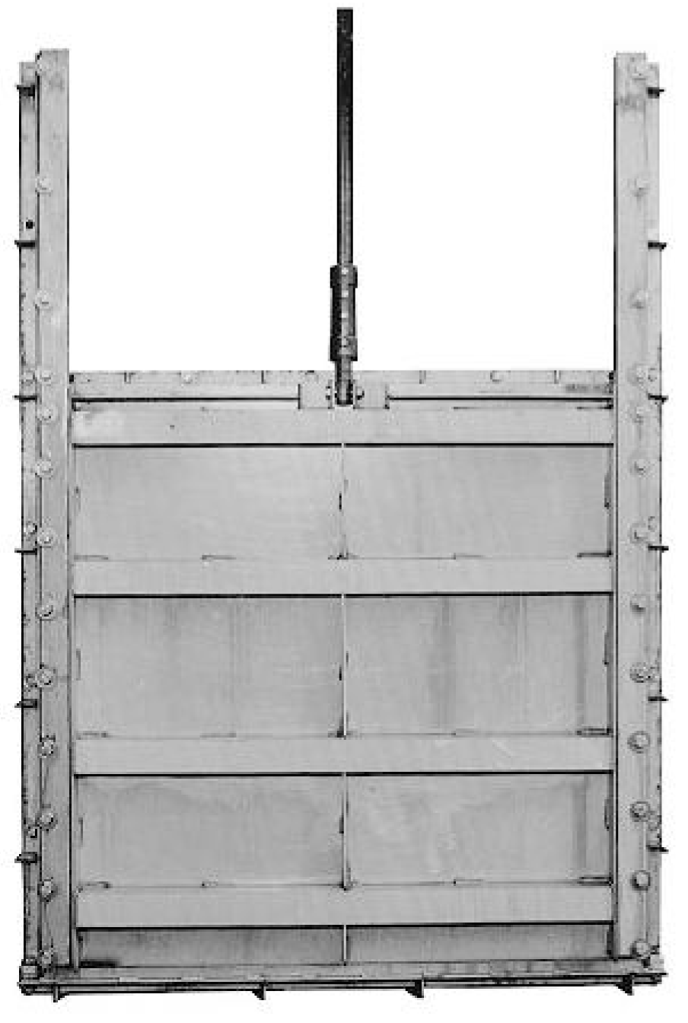
SS-250 Series
The best of technology for strength and longevity in corrosive atmospheres
304 or 316l stainless steel with UHMWPE plastic sliding and seating surfaces
Meets leakage requirements of AWWA c-561
ADVANTAGES:
  Corrosion Resistant
  Optimum Sealing Against Leakage
  Rugged Heavy Duty Design

Slide 30
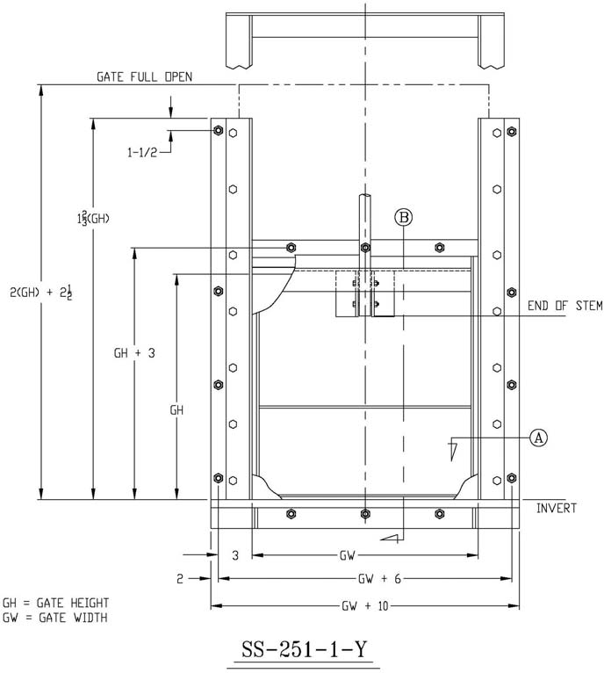
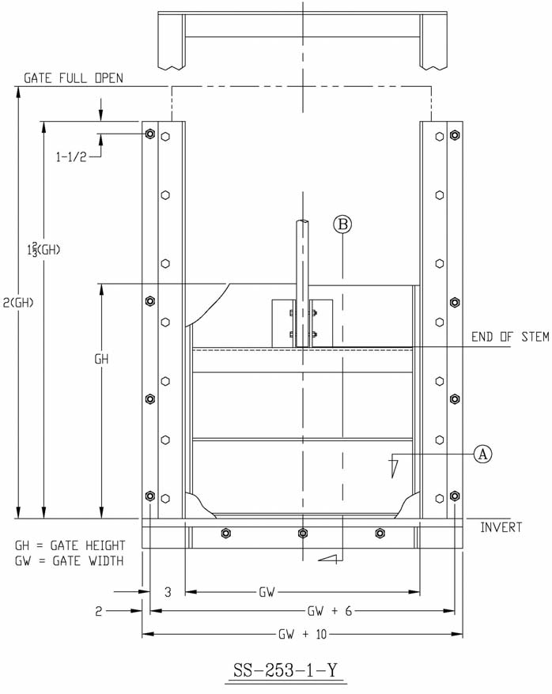
SS-251-1-Y and SS-253-1-Y

Slide 31
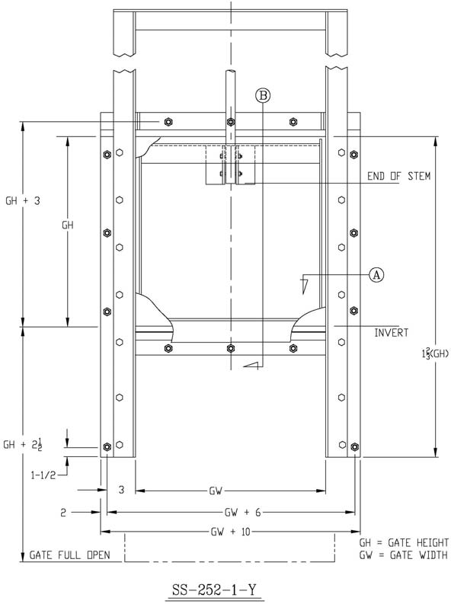
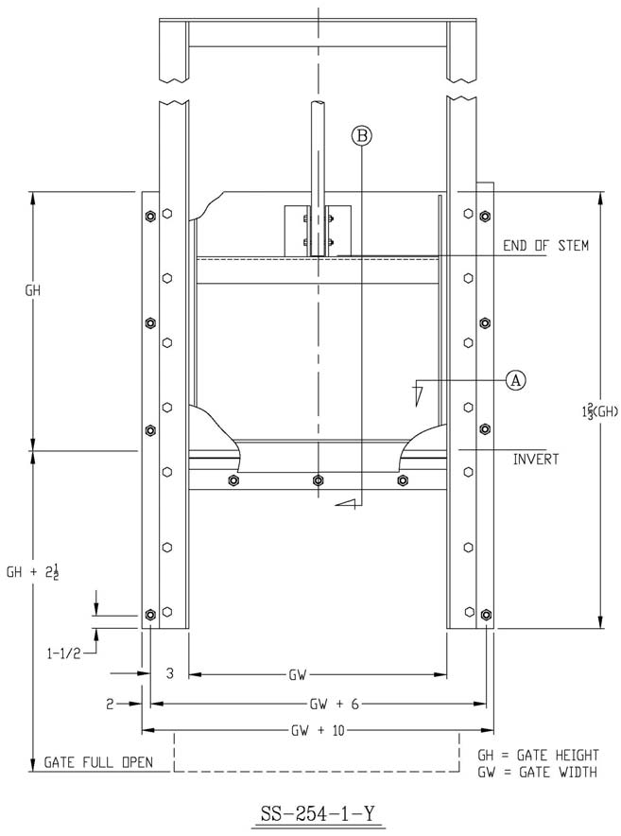
SS-252-1-Y and SS-254-1-Y

Slide 32
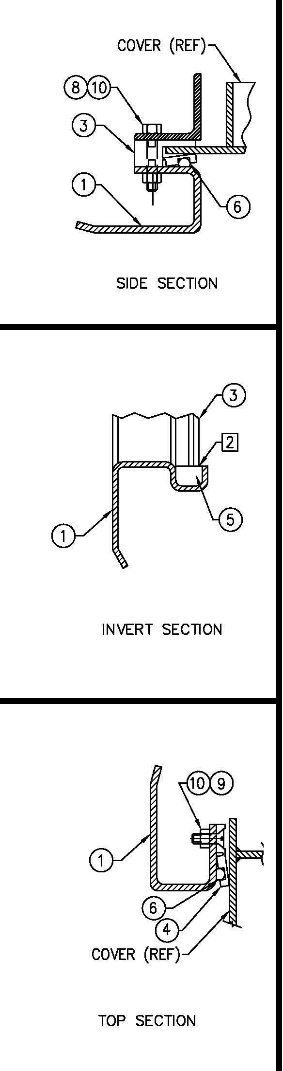
Typical Seal Assemblies for Fabricated Gates
Side seal assembly
Bottom seal assembly
Top seal assembly

Slide 33
Submittal Drawing
Notes:
33

Slide 34
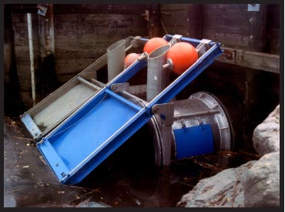
Self-Regulating Tidegate (SRT)
Restores tidal flushing of marshes without flooding of upland property behind dikes and levees
Restoration of estuarine plants, fish, shellfish, waterfowl & wildlife
Reduces mosquito breeding through natural control
Helps eliminate marsh fires (both peat and phragmites or tall reed grass)
Reduces sheet flooding of the marsh
Deepening of downstream channels resulting in improved navigation
Proven by 20 years experience

Slide 35
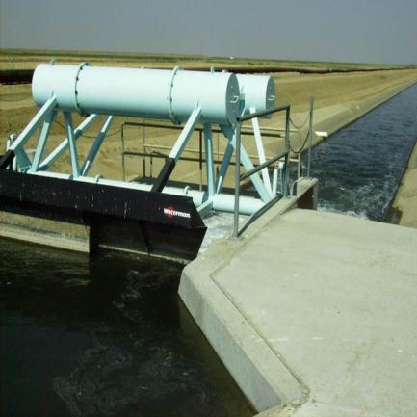
Type “C” Constant Upstream Level Gate
Automatic
No Operator, No Motor
Simple, Accurate, Fast and Reliable
For Flood Control
For Water Management Systems
For Irrigation
For Wastewater Treatment

Slide 36
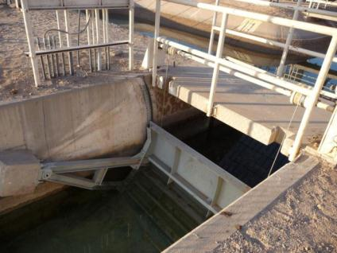
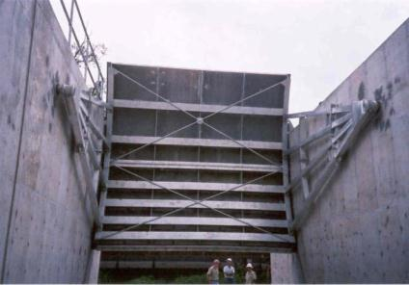
Radial Gates
Also called Tainter Gate
Can be engineered for unique applications or manufactured from standardized Waterman design
Lightweight economical gate that can be opened and closed with minimal effort.
Also can be ordered as replacement gates
USES:
• Maintenance of water elevations in canals
or spillways
• Increased storage capacity for reservoirs
• Diversion of water for irrigation
• Flow control preserving wide, clear
waterways
• Other areas requiring economical water
control

Slide 37
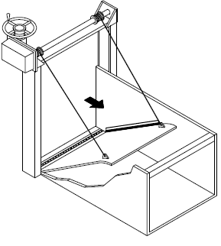
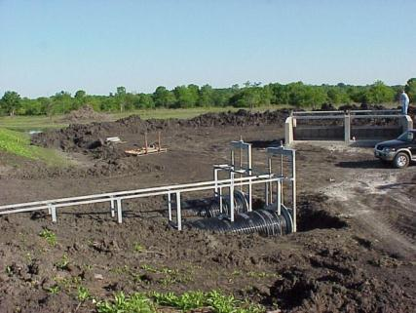
Tilting Weirs
Also called Overshot Gates
FOR PRECISE AUTOMATED OR
MANUAL LEVEL AND FLOW CONTROL

Slide 38
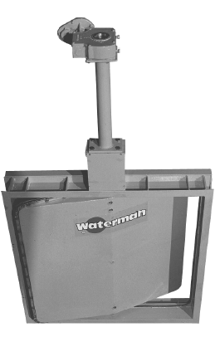
Butterfly Valve
Designed and manufactured for water-tight closure, ease on installation and operation, and adaptability to a variety of uses.
Available in four-sided seating models for orifice or in-line mounting and in three-sided channel mounted units
Each gate is designed and fabricated for specific installation and function requirements.

Slide 39

1912- 2012

